Slide 1
Fuzzy Sets and Fuzzy Logic
Lecture Module 18

Slide 2
Fuzzy Set
Zadeh developed the concept of ‘fuzzy sets’ in mid 60’s to account for numerous concepts used in human reasoning which are vague and imprecise e.g. tall, old
Fuzzy set is very convenient method for representing some form of uncertainty.
Later Zadeh developed ‘fuzzy logic’ to account for the imprecision of natural language quantities e.g. (many) and statements (e.g. not very likely).
In Fuzzy logic, a statement can be both true or false and also can be neither true nor false. Fuzzy logic is non monotonic logic.
Law of excluded middle does not hold true in fuzzy logic.
  A V ~A = True ; A ∧ ~A = False -- do not hold

Slide 3
Cont…
Well known paradoxes can not be solved using classical logic.
Russell’s paradox
  “All of the men in this town either shaved themselves or were shaved by the barber. And the barber only shaved the men who did not shave themselves“
  Answer to question: “ Who shaves the barber ? ” is contradictory
  Assume that he did shave himself. But we see from the story that he shaved only those men who did not shave themselves. Therefore, he did not shave himself.
  But we notice that every man either shaved himself or was shaved by the barber. So he did shave himself. We have a contradiction.

Slide 4
Example - Paradox
“ All Cretans are liars”, said the Cretan
If the Cretan is liar then his claim can not be believed and so is not a liar.
If he is not liar then he is telling truth. But because he is Cretan, he must therefore a liar.
The main idea behind Fuzzy systems is that truth values (in fuzzy logic) or membership values are indicated by a value in the range [0,1] with 0 for absolute falsity and 1 for absolute truth.
Fuzzy sets are often incorrectly assumed to indicate some form of probability.
Even though they can take on similar values, it is important to realize that membership grades are not probabilities.

Slide 5
Cont…
Probabilities on a finite universal set must add to 1 while there is no such requirement for membership grades.
Fuzzy set theory differs from conventional set theory as it allows each element of a given set to belong to that set to some degree.
In contrast to classical set theory each element either fully belongs to the set or is completely excluded from the set.
In other words, classical set theory represents a special case of the more general fuzzy set theory.
Elements in a fuzzy set X posses membership values between 0 and 1.The degree to which an element belongs to given set is called Grade of Membership.

Slide 6
Example
Represent “Helen is old” using probability theory and fuzzy set. Assume that Helen’s age is 75.
Probability approach:
We may assign the statement “Helen is old” the truth value of 0.95. The interpretation is that there is 95% chance of Helen is old
Fuzzy approach:
The statement could be translated into fuzzy set terminology as follows:
Helen is a member of the set of old people.
It could be expressed in symbolic notation of fuzzy set as λ_{OLD}(Helen) = 0.95 i.e., Helen’s degree of membership within the set of old people = 0.95

Slide 7
Distinction in two views
Important distinction between fuzzy systems and probability.
Although these two statements seem similar but they actually carry different meanings.
First view: There are 5% chances that Helen may not old
Second view: There is no chance of Helen being young and she is more or less old.
  Here µ_{OLD} is a membership function operation on the fuzzy set of old people (denoted OLD) which return a value between 0 and 1.

Slide 8
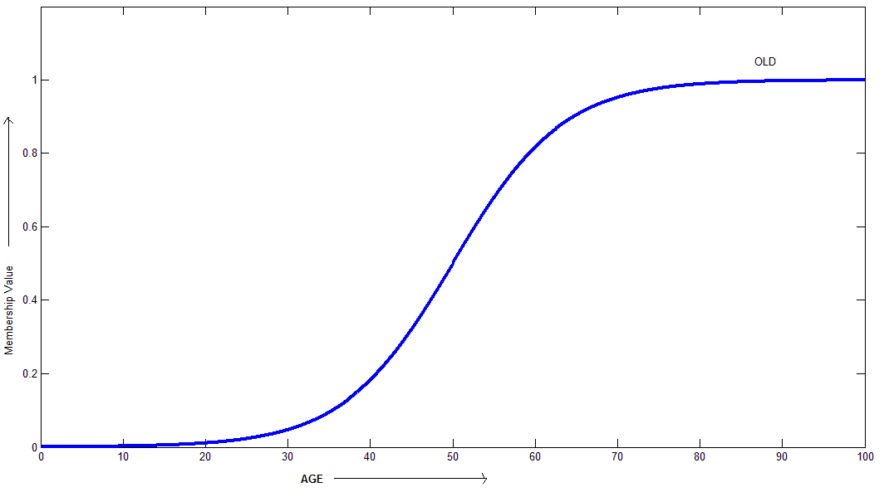
Membership function µ_{OLD} for the fuzzy set OLD is represented as

Slide 9
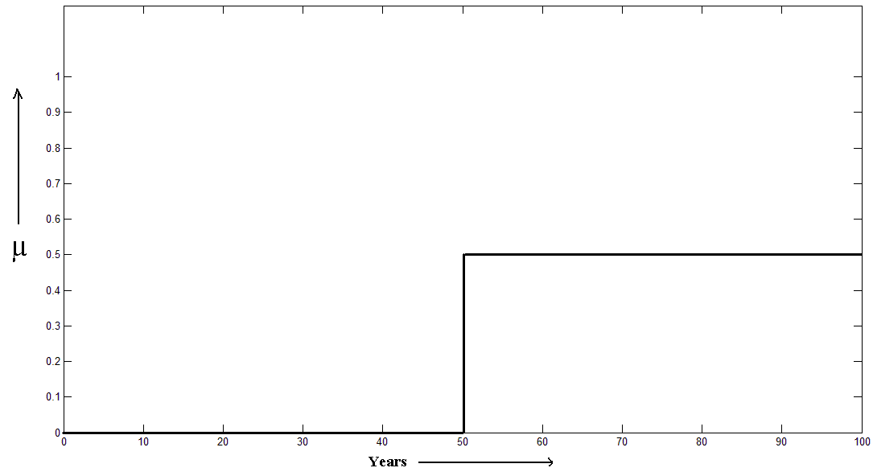
Membership function for crisp (conventional) set older than 50 years is represented as:

Slide 10
S-Function
Function for Analytical approximation of a fuzzy membership function is called S – function and is defined as:
      0, for x ≤ a
    2[(x-a) / (c-a)]²
    for a ≤ x ≤ b
    S(x, a, b, c) = 1- 2[(x-c) / (c-a)]²
    for b < x ≤ c
    1 for x ≥ c
  where a, b, c are the parameters of the curve and b is mid point.

Slide 11
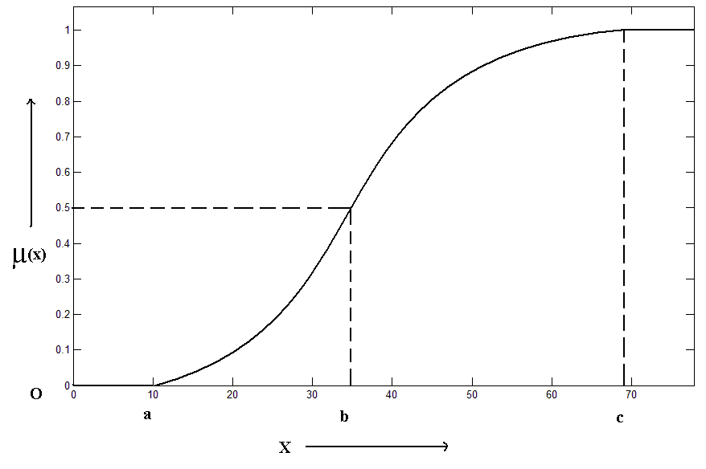

Slide 12
Cont…
S-shaped function can be used to represent the membership of different persons to fuzzy sets OLD, TALL, RICH, STRONG etc.
Definition: If X (Universal set) is a collection (set) of objects denoted by x, then a fuzzy set F in X is a set of ordered pairs
F = { (x, µ_{F(x)} ) | x ∈ X}
  where µ_{F(x)} is the membership function of x in F which maps x to the membership space [0,1].
Grade of membership 1 is assigned to those objects that fully and completely belong to F and 0 to those who do not belong to F at all.

Slide 13
Various Fuzzy Set Operations
Definition: (Intersection) The membership function µ_{C(x)} of the set C = A ∩ B is defined as µ_{C(x)} = min {µ_{A(x),} µ_{B(x)}}, x ∈ X.
Definition: (Union) The membership function µ_{C(x)} of C = A ∪ B is defined as µ_{C(x)}= max{µ_{A(x)} , µ_{B(x)} }, x ∈ X.
Definition: (Complement) Membership function of the complement of a fuzzy set A, µ_{A’(x)} is defined as µ_{A’(x)} = [1 - µ_{A(x)} ], x ∈ X.
Example: Let X = { 1,2,3,4,5,6,7}
A = { (3, 0.7), (5, 1), (6, 0.8) } and B = {(3, 0.9), (4, 1), (6, 0.6) }
A ∩ B = { (3, 0.7), (6, 0.6) }
A ∪ B = { (3, 0.9), (4, 1), (5, 1), (6, 0.8) }
A’ = { (1, 1), (2, 1), (3, 0.3), (4, 1), (6, 0.2), (7, 1) }

Slide 14
Additional operations
1. Equality: A = B, if µ_{A(x)} = µ_{B(x)}, ∀x ∈ X
2. Not equal: A ≠ B, if µ_{A(x)} ≠ µ_{B(x)} for at least one x ∈ X
3. Containment: A⊆ B if and only if µ_{A(x)} ≤ µ_{B(x)}, ∀x ∈ X
4. Proper subset: If A ⊆ B and A ≠ B
5. Product: A.B is defined as µ_{A.B(x)} = µ_{A(x)} . µ_{B(x)}
6. Power : A^{N} is defined as: µ_{A}^{N}_{(x)} = (µ_{A(x)})^{N}
7. Bold union : A ⊕ B is defined as:
µ_{A} _{⊕ B(x)} = Min [1, µ_{A(X)} + µ_{B(x)}]
8. Bold intersection: A Ο B is defined as:
µ_{A} _{Ο B(x)} = Max [0, µ_{A(x)} + µ_{B(x)} - 1]

Slide 15
Various Types of Membership Functions
S-shaped function
Z-shaped function
Triangular Membership Function
Trapezoidal Membership Function
Gaussian Distribution Function
Pi function
Vicinity function

Slide 16
Various Types of Membership Functions
S-shaped function
Z-shaped function
Triangular Membership Function
Trapezoidal Membership Function
Gaussian Distribution Function
Pi function
Vicinity function

Slide 17
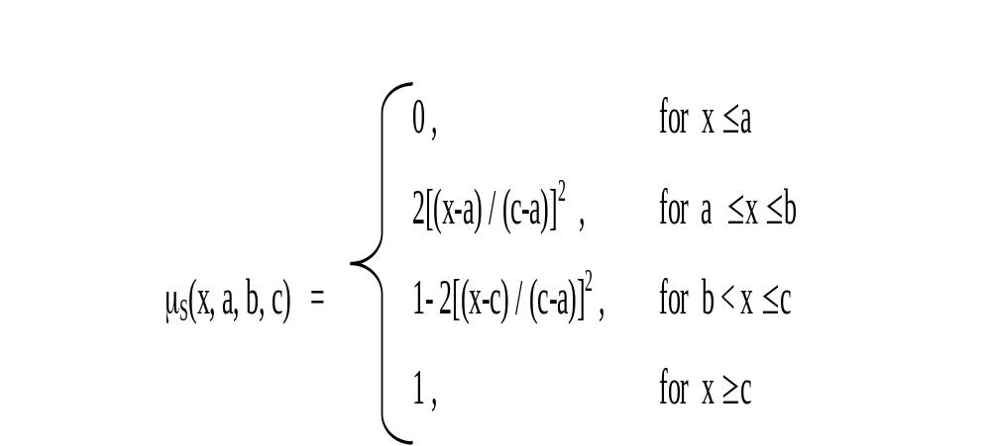
S-shaped function

Slide 18
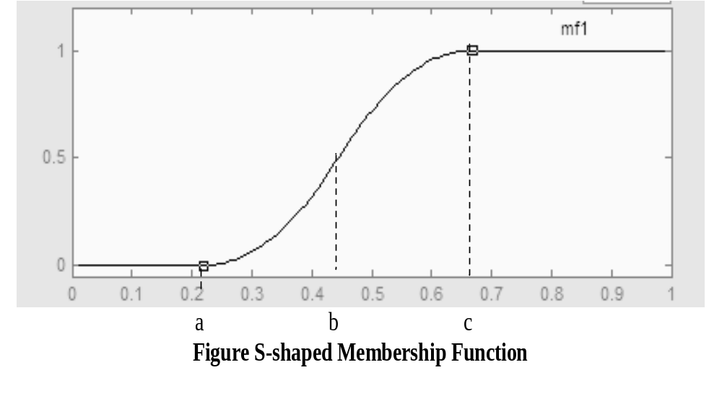
Graphical Representation of S-Shaped Function

Slide 19
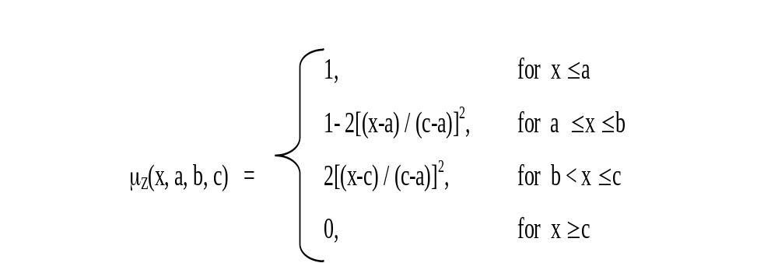
Z-Shaped Function
It represents an asymmetrical polynomial curve open to the left.
Z-membership function may be defined as follows:

Slide 20
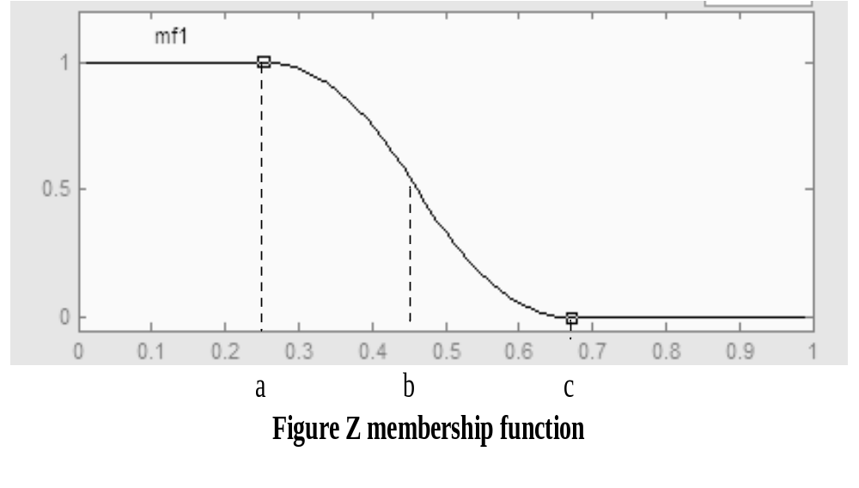
Graphical Representation

Slide 21
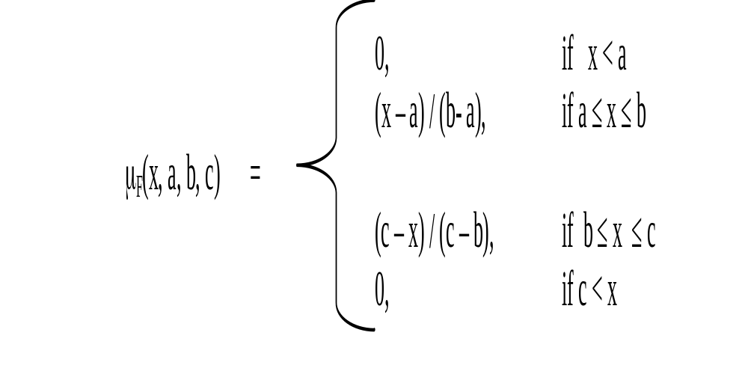
Triangular membership functions

Slide 22
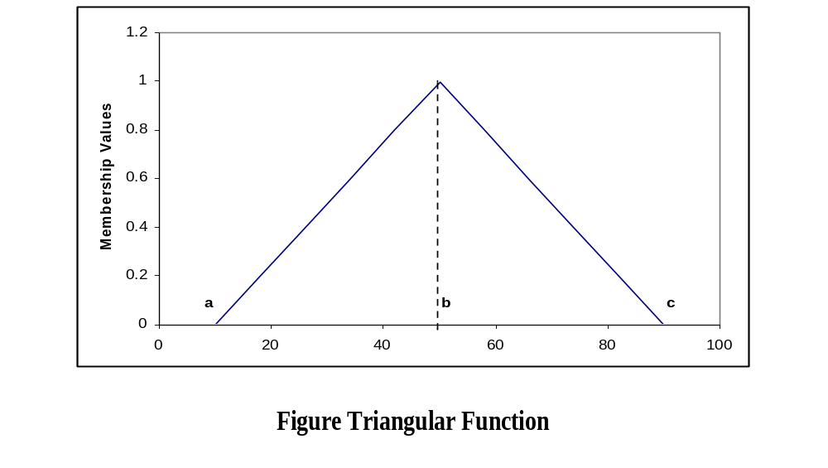
Cont…

Slide 23
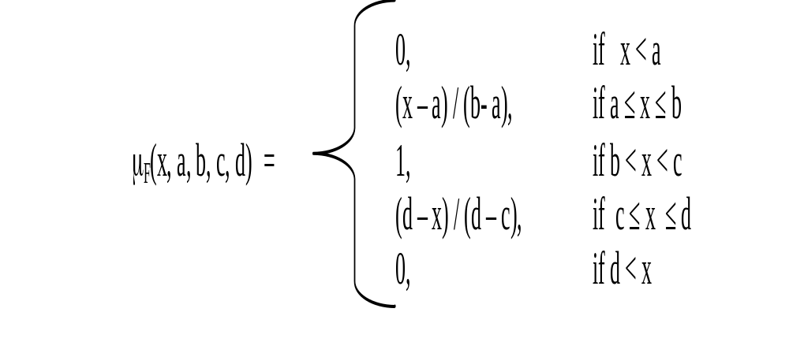
Trapezoidal membership function

Slide 24
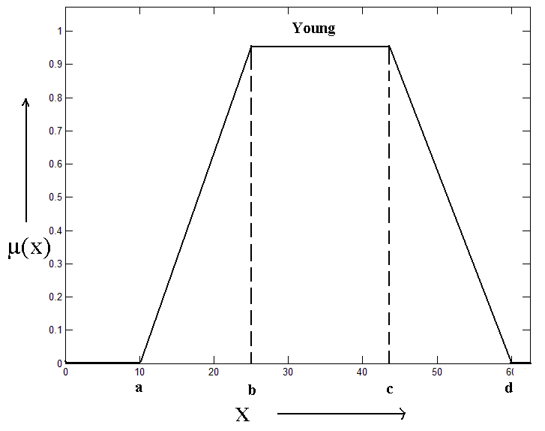
Cont…

Slide 25
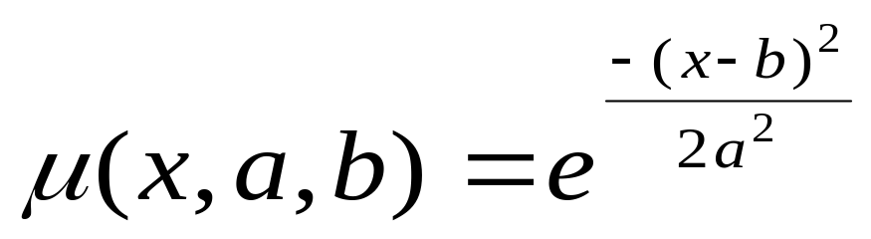
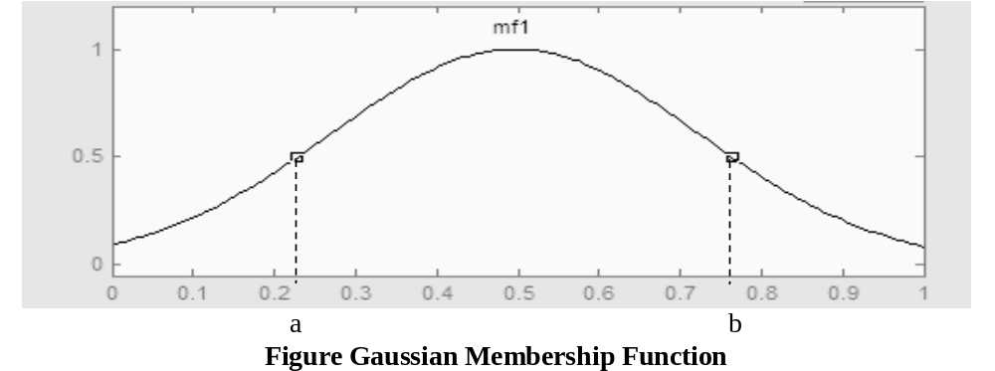
Gaussian membership function
The graph given in Fig. 10.6 is for parameters a = 0.22, b = 0.78

Slide 26
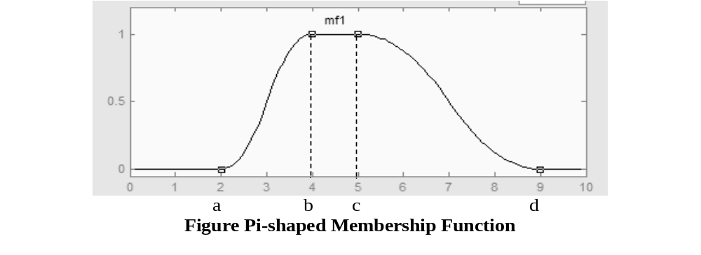
Pi Function
Pi-shaped curve is a spline-based curve which is named so because of its shape.
This membership function is evaluated at four points namely a, b, c, and d.
The parameters a and d locate the ‘feet’ of the curve, while b and c locate its ‘shoulders’. In the graph given in Fig. 10.14, a = 2, b = 4, c = 5, and d = 9.

Slide 27
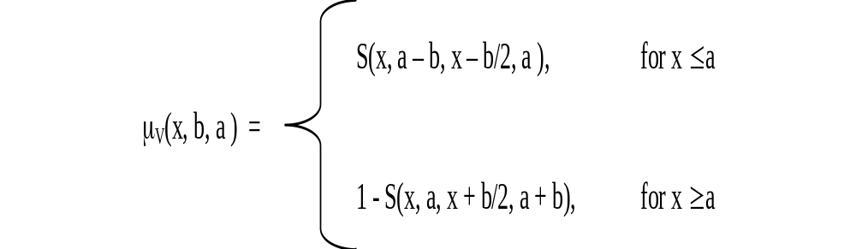
Vicinity function
To represent the statement “x is close to x0, where x0 is any fixed value of x”, vicinity function using S function as follows can be used:
This is also called π function. Here ‘b’ is called bandwidth.
Total width of the function between two zero points is equal to ‘2b’.

Slide 28
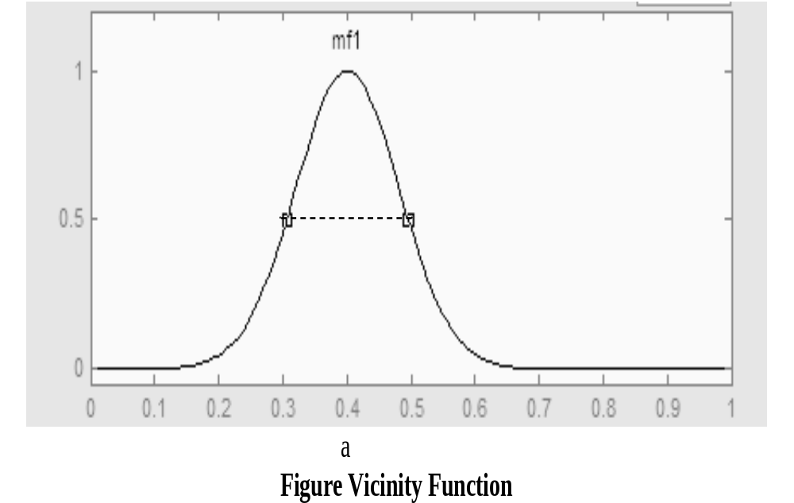

Slide 29
Basic Operations
For reshaping the membership functions, following three operations can be used.
  Dilation (DIL) : It increases the degree of membership of all members by spreading out the curve. For example, DIL(OLD) = more or less OLD. Its membership function is defined as: (µ_{A(x)})^{0.5}
  Concentration (CON): It decreases the degree of membership of all members. For example CONS(OLD) = very OLD. Its membership function is defined as: (µ_{A(x)})²
  Normalization (NORM) : It discriminates all membership degree in the same order unless maximum value of any member is 1. Its membership function is defined as: µ_{A(x)} / [max (µ_{A(x)})] , x ∈ X
  A fuzzy set is called normalized when at least one of its elements attains the maximum possible membership grade i.e., 1.

Slide 30
Methods for Determining Membership Functions
Membership functions can be designed by analyzing the problem in hand.
There are many possible forms of membership functions.
Most of the actual fuzzy control operations are drawn from a small set of different curves.
The methods for determining membership functions may be broadly classified into the following categories which are explained briefly as follows:
  Subjective evaluation and elicitation
  Converted frequencies or probabilities
  Physical measurement
  Learning and adaptation

Slide 31
Cont..
Subjective evaluation and elicitation:
  Since fuzzy sets are usually intended to model people's cognitive states, they can be determined from certain elicitation procedures.
  Typically, these procedures are provided by the experts in the problem area.
  For this purpose, a more constrained set of possible curves are given from which an appropriate one can be chosen.
  Users can be tested using psychological tests for more complex methods.

Slide 32
Cont...
Converted frequencies or probabilities:
  It may be possible to use information taken in the form of frequency histograms or other probability curves as the basis to construct a membership function.
  There are a number of possible conversion methods, each with its own mathematical and methodological strengths and weaknesses.
  However, it should always be remembered that membership functions are NOT (necessarily) equivalent to probabilities.

Slide 33
Cont...
Physical measurement:
  Although many applications of fuzzy logic use physical measurement, almost none of them measure the membership grade directly.
  Instead, a membership function is obtained from another method, and it is then used to calculate individual membership grades of data.
Learning and adaptation:
  Membership functions of fuzzy sets can be learned and adapted from a given set to functions to suit the application.

